Slide 1
Chapter 1: Introduction to Switched Networks
Routing and Switching
Notes:
Cisco Networking Academy program
Routing & Switching
Chapter 1: Introduction to Switched Networks

Slide 2
Chapter 1
1.0 Introduction
1.1 LAN Design
1.2 Switched Environment
1.3 Summary
Notes:
Chapter 1

Slide 3
Chapter 1: Objectives
Upon completion of this chapter, you will be able to:
Describe convergence of data, voice, and video in the context of switched networks.
Describe a switched network in a small-to-medium-sized business.
Explain the process of frame forwarding in a switched network.
Compare a collision domain to a broadcast domain.
Notes:
1.

Slide 4
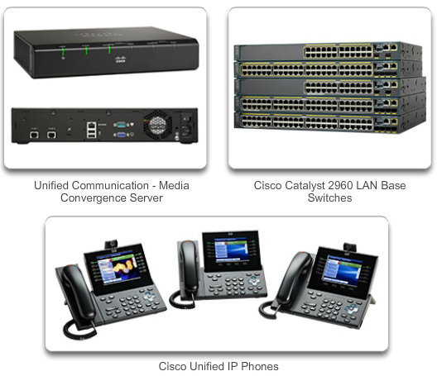
Converged Networks Growing Complexity of Networks
Our digital world is changing.
Information must be accessed from anywhere in the world.
Networks must be secure, reliable, and highly available.
Notes:
1.1.1.1 Growing Complexity of Networks

Slide 5
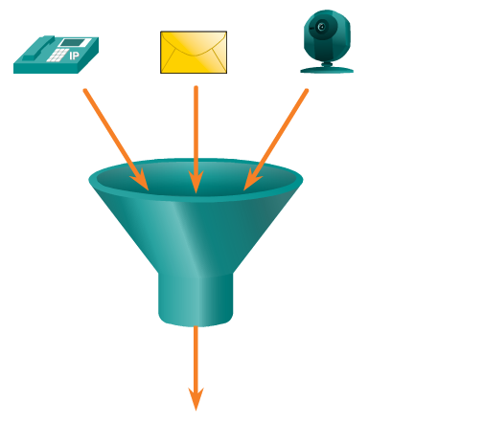
Converged Networks Elements of a Converged Network
Collaboration is a requirement.
To support collaboration, networks employ converged solutions.
Data services include voice systems, IP phones, voice gateways, video support, and video conferencing.
Call control, voice messaging, mobility, and automated attendant are also common features.
Notes:
1.1.1.2 Elements Of A Converged Network

Slide 6
Converged Networks Benefits of a Converged Network
Multiple types of traffic; only one network to manage.
Substantial savings over installation and management of separate voice, video, and data networks.
Integrates IT management.
Notes:
1.1.1.2 Elements Of A Converged Network

Slide 7
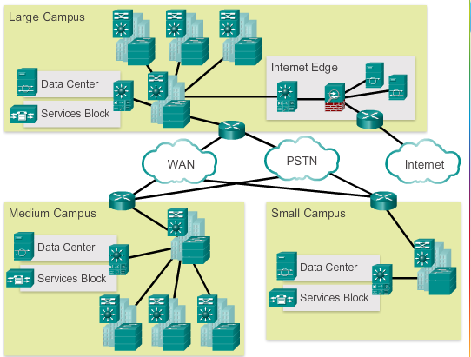
Converged Networks Borderless Switched Networks
The Cisco Borderless Network is a network architecture that allows organizations to connect anyone, anywhere, anytime, and on any device securely, reliably, and seamlessly.
Cisco Borderless Network is designed to address IT and business challenges, such as supporting the converged network and changing work patterns.
Notes:
1.1.1.3 Borderless Switched Networks

Slide 8
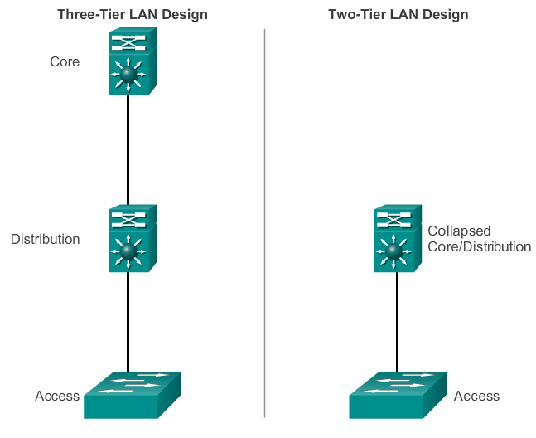
Converged Networks Hierarchy in the Borderless Switched Network
Borderless switched network design guidelines are built upon the following principles:
Hierarchical
Modularity
Resiliency
Flexibility
Notes:
1.1.1.4 Hierarchy in the Borderless Switched Network

Slide 9
Converged Networks Hierarchy in the Borderless Switched Network
Hierarchical
Facilitates understanding the role of each device at every tier, simplifies deployment, operation, and management, and reduces fault domains at every tier
Modularity
Allows seamless network expansion and integrated service enablement on an on-demand basis
Resiliency
Satisfies user expectations for keeping the network always on
Flexibility
Allows intelligent traffic load sharing by using all network resources
Notes:
1.1.1.4 Hierarchy in the Borderless Switched Network

Slide 10
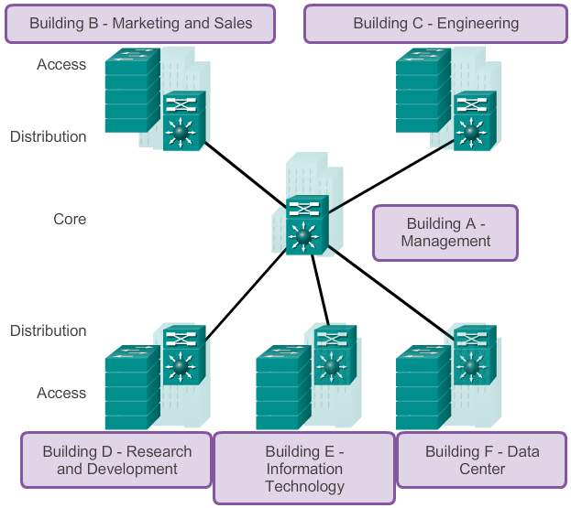
Converged Networks Core, Distribution, Access
Notes:
1.1.1.5 Core, Distribution, Access

Slide 11
Converged Networks Core, Distribution, Access
Access Layer
The access layer represents the network edge, where traffic enters or exits the campus network.
the primary function of an access layer switch is to provide network access to the user
connect to distribution layer switches, which implement network foundation technologies such as routing, quality of service, and security.
Notes:
1.1.1.5 Core, Distribution, Access

Slide 12
Converged Networks Core, Distribution, Access
Distribution Layer
The distribution layer interfaces between the access layer and the core layer to provide many important functions:
Aggregating large-scale wiring closet networks
Aggregating Layer 2 broadcast domains and Layer 3 routing boundaries
Providing intelligent switching, routing, and network access policy functions to access the rest of the network
Providing high availability through redundant distribution layer switches to the end-user and equal cost paths to the core
Providing differentiated services to various classes of service applications at the edge of network
Notes:
1.1.1.5 Core, Distribution, Access

Slide 13
Converged Networks Core, Distribution, Access
Core Layer
The core layer is the network backbone.
It connects several layers of the campus network
The core layer serves as the aggregator for all of the other campus blocks and ties the campus together with the rest of the network.
The primary purpose of the core layer is to provide fault isolation and high-speed backbone connectivity.
Notes:
1.1.1.5 Core, Distribution, Access

Slide 14
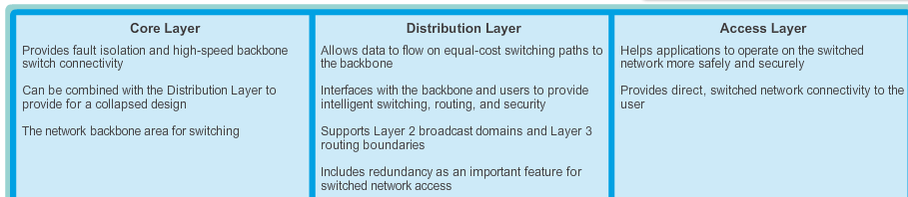
Converged Networks Core, Distribution, Access
Notes:
1.1.1.5 Core, Distribution, Access

Slide 15
Switched Networks Role of Switched Networks
Switching technologies are crucial to network design.
Switching allow traffic to be sent only where it is needed in most cases, using fast methods.
A switched LAN:
Allows more flexibility
Allows more traffic management
Supports quality of service, additional security, wireless, IP telephony, and mobility services
Notes:
1.1.2.1 Role of Switched Networks

Slide 16
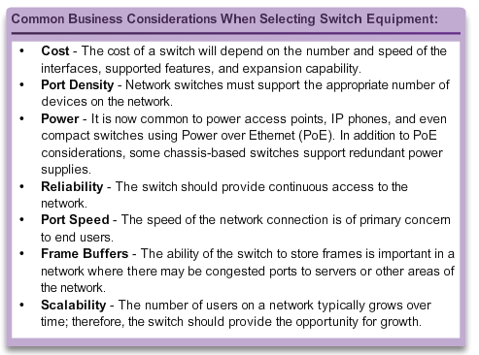
Switched Networks Form Factor
Notes:
1.1.2.2 Form Factor

Slide 17
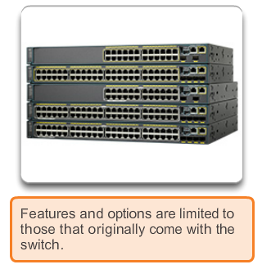
Switched Networks Form Factor
Fixed Platform
Notes:
1.1.2.2 Form Factor

Slide 18
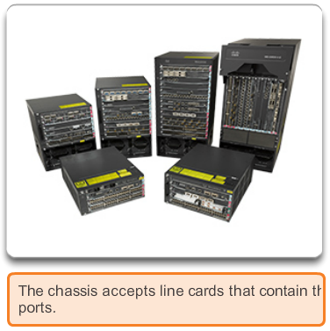
Switched Networks Form Factor (cont.)
Modular Platform
Notes:
1.1.2.2 Form Factor

Slide 19
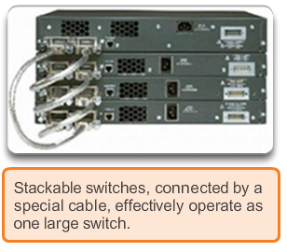
Switched Networks Form Factor (cont.)
Stackable Platform
Notes:
1.1.2.2 Form Factor

Slide 20
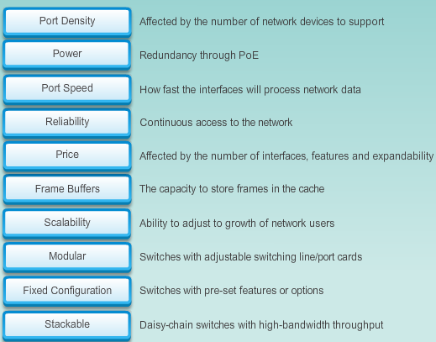
Switched Networks Form Factor
Notes:
1.1.2.2 Form Factor

Slide 21
Frame Forwarding Switching as a General Concept
A switch makes a decision based on ingress and a destination port.
A LAN switch keeps a table that it uses to determine how to forward traffic through the switch.
Cisco LAN switches forward Ethernet frames based on the destination MAC address of the frames.
Notes:
1.2.1.1 Switching as a General Concept in Networking and Telecommunications

Slide 22
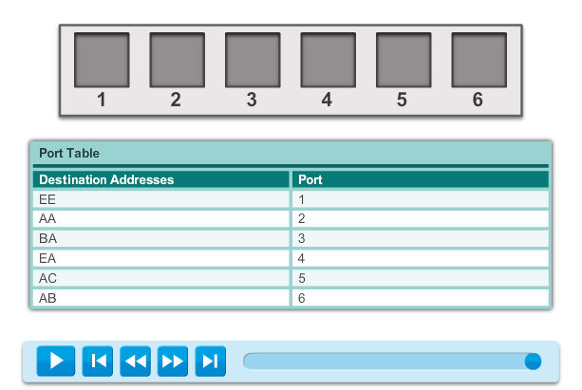
Frame Forwarding Switching as a General Concept
Animation 1.2.1.1
Notes:
1.2.1.1 Switching as a General Concept in Networking and Telecommunications

Slide 23
Frame Forwarding Dynamically Populating a Switch MAC Address Table
A switch must first learn which devices exist on each port before it can transmit a frame.
It builds a table called a MAC address or content addressable memory (CAM) table.
The mapping device <-> port is stored in the CAM table.
CAM is a special type of memory used in high-speed searching applications.
The information in the MAC address table used to send frames.
When a switch receives an incoming frame with a MAC address that is not found in the CAM table, it floods it to all ports, but the one that received the frame.
Notes:
1.2.1.2 Dynamically Populating a Switch MAC Address Table

Slide 24
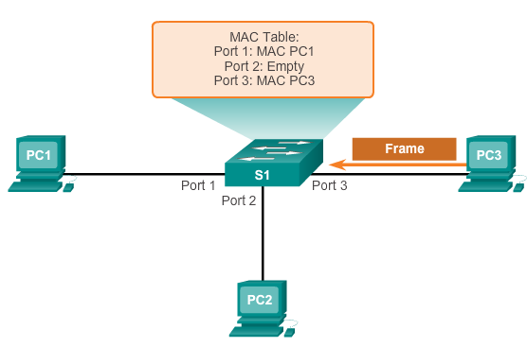
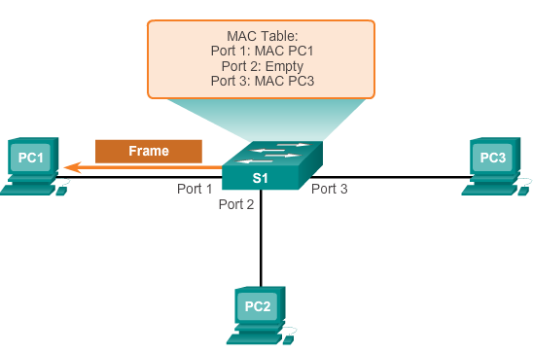
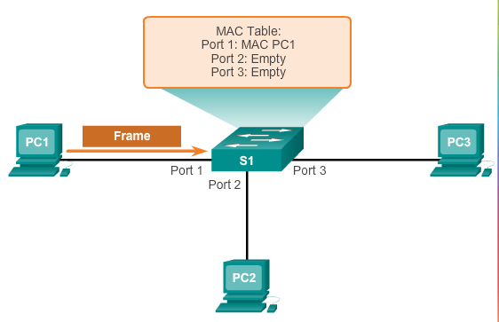
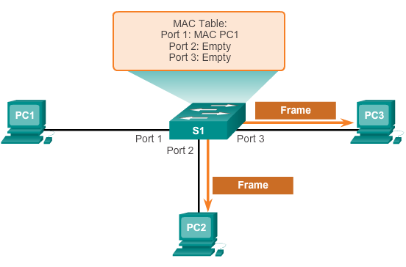
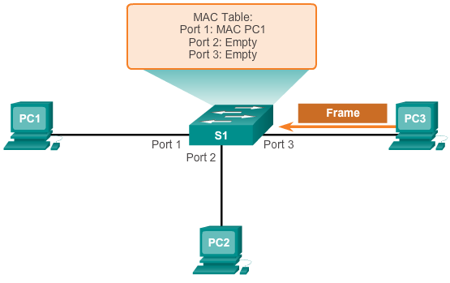
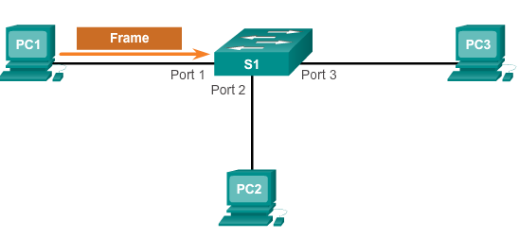
Frame Forwarding Dynamically Populating a Switch MAC Address Table
Notes:
1.2.1.2 Dynamically Populating a Switch MAC Address Table

Slide 25
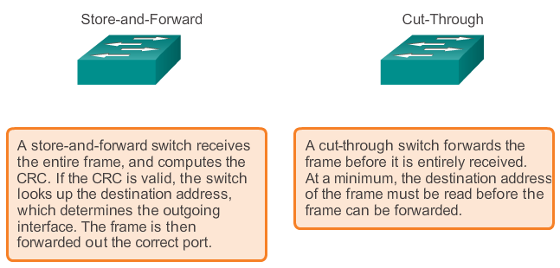
Frame Forwarding Switch Forwarding Methods
Add a header
Notes:
1.2.1.3 Switch Forwarding Methods

Slide 26
Frame Forwarding Store-and-Forward Switching
Allows the switch to:
Check for errors (via FCS check)
Perform automatic buffering
Slower forwarding process
Notes:
1.2.1.4 Store-and-Forward Switching

Slide 27
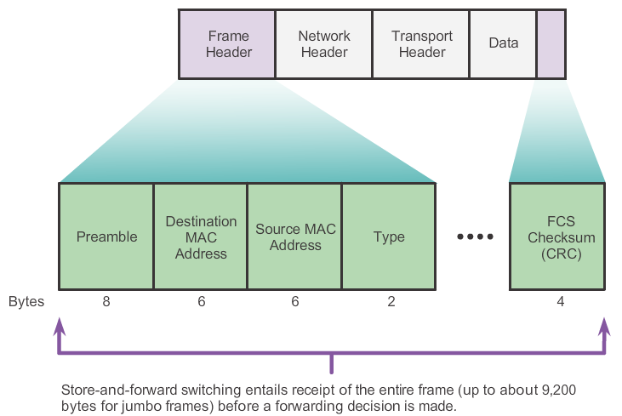
Frame Forwarding Store-and-Forward Switching (cont.)
Notes:
1.2.1.4 Store-and-Forward Switching

Slide 28
Frame Forwarding Cut-Through Switching
Allows the switch to start forwarding in about 10 microseconds
No FCS check
No automatic buffering
Notes:
1.2.1.5 Cut-Through Switching

Slide 29
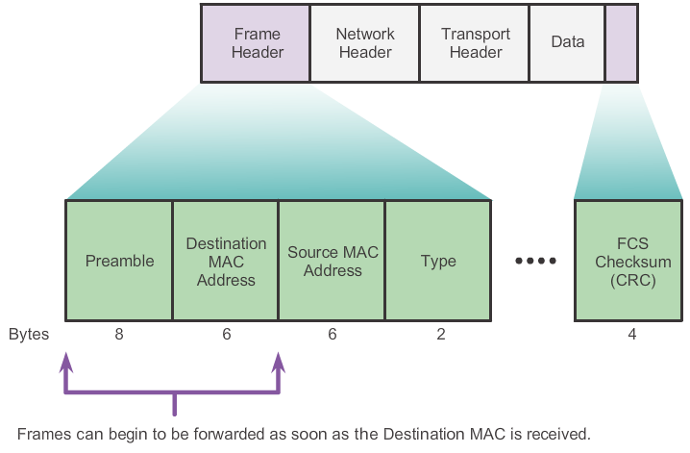
Frame Forwarding Cut-Through Switching (cont.)
Notes:
1.2.1.5 Cut-Through Switching

Slide 30
Switching Domains Collision Domains
A collision domain is the segment where devices must compete to communicate.
All ports of a hub belong to the same collision domain.
Every port of a switch is a collision domain on its own.
A switch break the segment into smaller collision domains, easing device competition.
Notes:
1.2.2.1 Collision Domains

Slide 31
Switching Domains Broadcast Domains
A broadcast domain is the extend of the network where a broadcast frame can be heard.
Switches forward broadcast frames to all ports; therefore, switches do not break broadcast domains.
All ports of a switch, with its default configuration, belong to the same broadcast domain.
If two or more switches are connected, broadcasts are forwarded to all ports of all switches, except for the port that originally received the broadcast.
Notes:
1.2.2.2 Broadcast Domains

Slide 32
Switching Domains Alleviating Network Congestion
Switches help alleviating network congestion by:
Facilitating the segmentation of a LAN into separate collision domains
Providing full-duplex communication between devices
Taking advantage of their high-port density
Buffering large frames
Employing high-speed ports
Taking advantage of their fast internal switching process
Having a low, per-port cost
Notes:
1.2.2.4 Alleviating Network Congestion

Slide 33
Chapter 1: Summary
In this chapter, you learned:
The trend in networks is towards convergence using a single set of wires and devices to handle voice, video, and data transmission.
There has been a dramatic shift in the way businesses operate.
There are no physical offices or geographic boundaries constraints. Resources must now be seamlessly available anytime and anywhere.
The Cisco Borderless Network architecture enables different elements, from access switches to wireless access points, to work together and allow users to access resources from any place at any time.
Notes:
Chapter 1 Summary

Slide 34
Chapter 1: Summary (cont.)
The traditional, three-layer hierarchical design model divides the network into core, distribution, and access layers, and allows each portion of the network to be optimized for specific functionality.
It provides modularity, resiliency, and flexibility, which provides a foundation that allows network designers to overlay security, mobility, and unified communication features.
Switches use either store-and-forward or cut-through switching.
Every port on a switch forms a separate collision domain allowing for extremely high-speed, full-duplex communication.
Switch ports do not block broadcasts and connecting switches can extend the size of the broadcast domain, often resulting in degraded network performance.
Notes:
Chapter 1 Summary

Slide 35


